Slide 1
Floyd-Warshall Algorithm
Dr. Yasir | Programming Domain

Slide 2
Floyd-Warshall Algorithm is an algorithm for finding the shortest path between all the pairs of vertices in a weighted graph. T
This algorithm works for both the directed and undirected weighted graphs.
But, it does not work for the graphs with negative cycles (where the sum of the edges in a cycle is negative).
This algorithm follows the dynamic programming approach to find the shortest paths.
Notes:
Insert a map of your country.

Slide 3
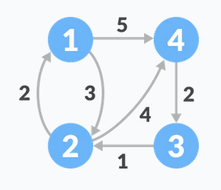
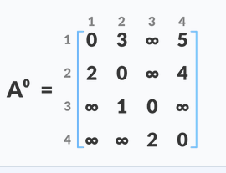
How Floyd-Warshall Algorithm Works?
Notes:
Insert a map of your country.

Slide 4
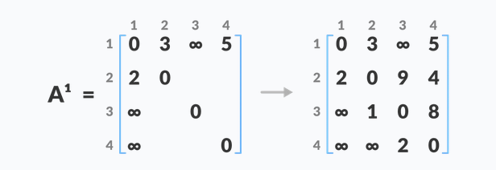
Notes:
Insert a map of your country.

Slide 5
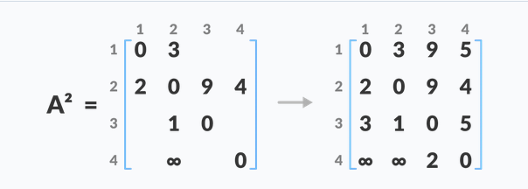
Notes:
Insert a map of your country.

Slide 6
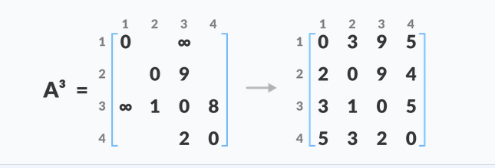
Notes:
Insert a map of your country.

Slide 7
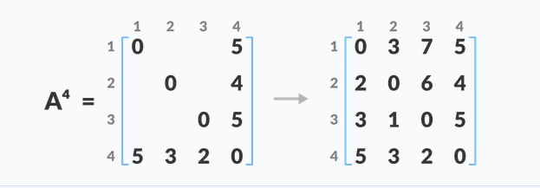
A⁴ gives the shortest path between each pair of vertices.
Notes:
Insert a map of your country.

Slide 8
Floyd-Warshall Algorithm
n = no of vertices
A = matrix of dimension n*n
for k = 1 to n
for i = 1 to n
for j = 1 to n
A^{k}[i, j] = min (A^{k-1}[i, j], A^{k-1}[i, k] + A^{k-1}[k, j])
return A
Notes:
Insert a map of your country.

